Slide 1
Windows Server containers in Kubernetes Workshop
Craig Peters, Ralph Squillace

Slide 2
Introductions and Logistics

Slide 3
Who are we and why are we here?
Please, ask for help
Work singly or together
Whatever works for you

Slide 4
Resources
Wifi:
H Porta Fira
PIN: LB4U36
Cluster access: check your email for a kube config
Room logistics and schedule
Restrooms
2 labs
Break
1 lab

Slide 5
Windows Server Containers in Kubernetes
kubectl
Universe of ecosystem tooling

Slide 6
ASP.NET Lift-and-shift Overview
Explore Windows container basics
1
Package an ASP.NET app in a Windows container
2
Run the app on a Kubernetes Cluster
3
Configure services on Linux to work with the App
4

Slide 7
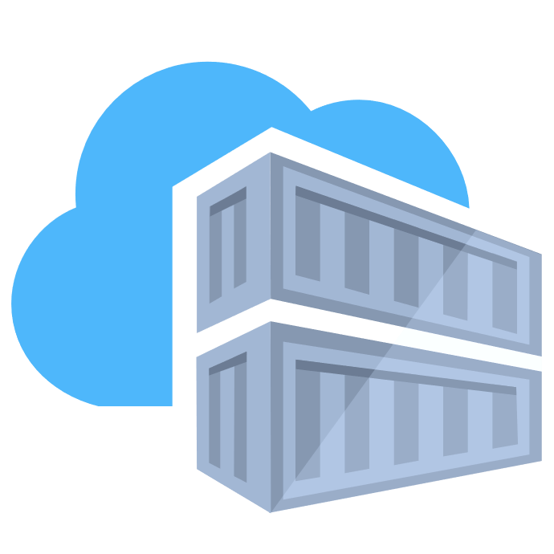
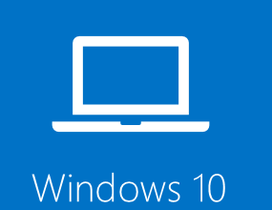
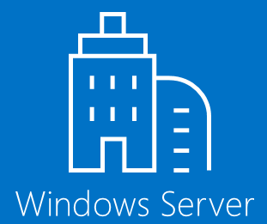
Windows Server Container Fundamentals
Container Image
Container Repository
Container Host

Slide 8
What is a Windows Container?
Traditional virtual machines = hardware virtualization
Hyper-V containers— Isolation plus performance
Application
VM
VM
VM
Container
Container
Container
OS
Kernel
Kernel
Kernel
Hardware
Hyper-V
Containers = operating system virtualization
Windows Server containers— Maximum speed and density
Container
Container
Container
Container
Container
Container
Processes
Kernel
Kernel

Slide 9
Anatomy of a Windows container
Application code
Application layers
Pre-requisites | Customizations
Customization layers
Nanoserver, Servercore, Windows
Base OS—layer

Slide 10
How Kubernetes Works
Kubernetes control
Worker node
kubectl, etc
kubelet
kube-proxy
Internet
Kubernetes users communicate with API server and apply desired state
Master node
Docker
Pod
Pod
Master nodes actively enforce desired state on worker nodes
API server
Containers
Containers
Worker nodes support communication between containers
-controller-manager
-scheduler
Worker node
kubelet
kube-proxy
Internet
Worker nodes support communication from the Internet
replication, namespace, serviceaccounts, etc.
etcd
Docker
Pod
Pod
Containers
Containers

Slide 11

How Kubernetes Works with Windows Server Containers
Kubernetes control
Worker node
kubectl, etc
kubelet
kube-proxy
Internet
Kubernetes users communicate with API server and apply desired state
Master node
Docker
Pod
Pod
Master nodes actively enforce desired state on worker nodes
API server
Containers
Containers
Worker nodes support communication between containers
-controller-manager
-scheduler
Worker node
kubelet
kube-proxy
Internet
Worker nodes support communication from the Internet
replication, namespace, serviceaccounts, etc.
etcd
Docker
Pod
Pod
Containers
Containers

Slide 12
Windows Server Containers in Kubernetes: Limitations & Difference from Linux Containers
Almost identical, except:
Control plane doesn’t run on Windows; Linux only
K8s supports Windows process isolated containers only
No Hyper-V isolation (yet)
Windows OS base image version must match Host OS (for now)
Identity works differently in Windows - gMSA support is in alpha
Misc…
Ref: Kubernetes Docs for Windows – Supported Functionality and Limitations

Slide 13
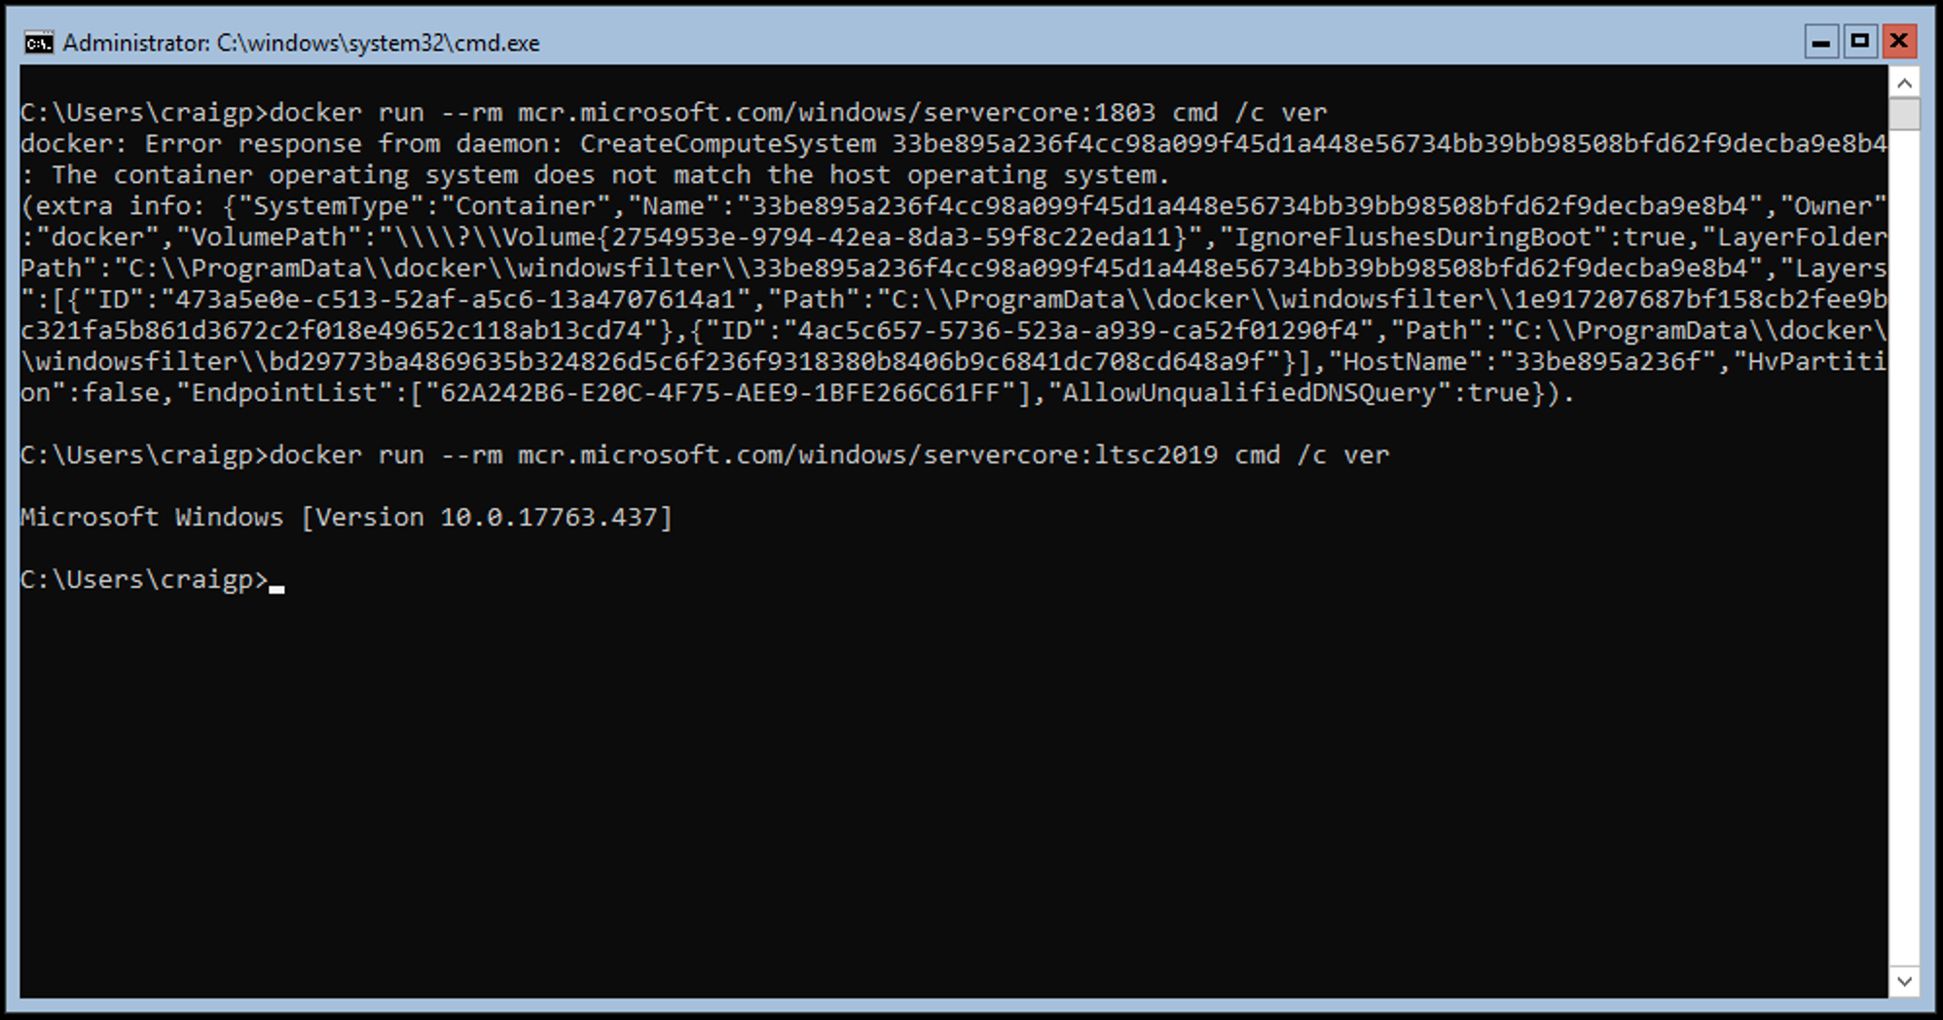

Slide 14
Lab 1:
Run Windows Server container images to understand Windows Containers
Setup git and Azure CLI
Get access to the repo https://github.com/craiglpeters/fabrikamfiber/
Setup tools including kubectl
Get access to the cluster
Examine the Windows nodes

Slide 15
Sample App
End Users
ASP .NET+ IIS
Notes:
Users log into the website with their enterprise domain credentials.
ASP.NET verifies those credentials and uses the identity to authorize access to resources.
The IIS worker process runs as a service account to communicate with SQL using integrated Windows authentication.
SQL has to verify the IIS service account identity to grant access to the database.

Slide 16

Sample App
Windows Server VM
Windows Server Container
End Users
ASP .NET+ IIS
Notes:
Users log into the website with their enterprise domain credentials.
ASP.NET verifies those credentials and uses the identity to authorize access to resources.
The IIS worker process runs as a service account to communicate with SQL using integrated Windows authentication.
SQL has to verify the IIS service account identity to grant access to the database.

Slide 17
Pro tip: Choose the right Base Image
Nanoserver
Servercore
Windows
Image Size | 100 Mb | 1.49 Gb | 3.57 Gb
API Surface | .NET Core | .NET Framework | Full Windows API set
Use Case | New apps | Traditional server workloads | DirectX, print server, new app experiences
Available Since | Windows Server 2016 | Windows Server 2016 | Windows Server 2019
Notes:
Mention other images like IoT
.NET core on Server Core container (some .NET Core packages don’t run on Nano)

Slide 18
Pro tip: Choose the right Base Image
Nanoserver
Servercore
Windows
dotnet/framework
microsoft/aspnet
microsoft/iis
microsoft/wcf
Image Size | 100 Mb | 1.49 Gb | 3.57 Gb
API Surface | .NET Core | .NET Framework | Full Windows API set
Use Case | New apps | Traditional server workloads | DirectX, print server, new app experiences
Available Since | Windows Server 2016 | Windows Server 2016 | Windows Server 2019
dotnet/core
microsoft/powershell
(open for adoption)
Notes:
Mention other images like IoT
.NET core on Server Core container (some .NET Core packages don’t run on Nano)

Slide 19
Lab 2
MSBUILD the ASP .NET App
Consider your Windows container Base Image
Dockerfile
Docker build

Slide 20
Break

Slide 21
Mixed OS Workloads in Kubernetes
Linux VM
Windows Server VM
Linux Container
Windows Server Container
Ingress Controller
End Users
ASP .NET+ IIS

Slide 22
Scheduling pods with mixed OS clusters
ImagePull
nodeSelector
Taints and tolerations
Node affinity/anti-affinity
Implementing in Helm

Slide 23
Lab 3: Linux Ingress Controller in front of IIS
Deployment for the Windows container
Deployment for the back-end database (running on Linux)
nginx Linux docker image
Pod spec for Ingress controller

Slide 24
Thank you.

Slide 25
Additional Resources
Windows Containers in Kubernetes Docs https://kubernetes.io/docs/setup/windows/intro-windows-in-kubernetes/
Modernize .NET Apps https://docs.microsoft.com/en-us/dotnet/standard/modernize-with-azure-and-containers/

Slide 26
Comparing Linux and Windows Container Runtimes
Ref: Introducing Host Compute Service

Slide 27
Roadmap for Container Runtimes
Ref: Container platform tools doc

Slide 28
Manage Kubernetes with ease
Infrastructure automation
Azure managed control plane
App/ workload definition
Self-managed master node(s)
Automated provisioning, upgrades, patches
High reliability, availability
Easy, secure cluster scaling
Self-healing
API server monitoring
At no charge
Kubernetes API endpoint
etcd Store
User
API server
Scheduler
Controller Manager
Cloud Controller
Schedule pods over private tunnel
Customer Node pool
Customer Node pool
VM
VM
VM
VM
Docker
Docker
Docker
Docker
Docker
Docker
Docker
Docker
Pods
Pods
Pods
Pods
Pods
Pods
Pods
Pods
kubelet
kube-proxy
kubelet
kube-proxy
kubelet
kube-proxy
kubelet
kube-proxy
Notes:
Look at animations – this slide simplifies the one we had before (next slide hidden) and can serve the same purpose.
“When we talk about managing Kubernetes with ease, what do we mean? The foundation of a Kubernetes cluster is the Master nodes for system components like the API server, etcd store, and scheduler. This is where users provision and manages their workloads and the cluster. Managing these components involves ensuring monitoring the API server availability, ensure HA/DR of the etcd store, safely mange upgrades across Kubernetes versions, safely scaling the cluster in and out, patching master and agent VM nodes, and on and on… This is complex, error-prone, and expensive.
(click)
With AKS, those tasks are on us. We bring automated provisioning, upgrades and patches. High availability and reliability, easy scaling, monitoring of API server and control plane – all at no charge. You only pay for the VMs running your containers, giving you freedom to focus on your applications and business needs they fulfill.”

